Slide 1
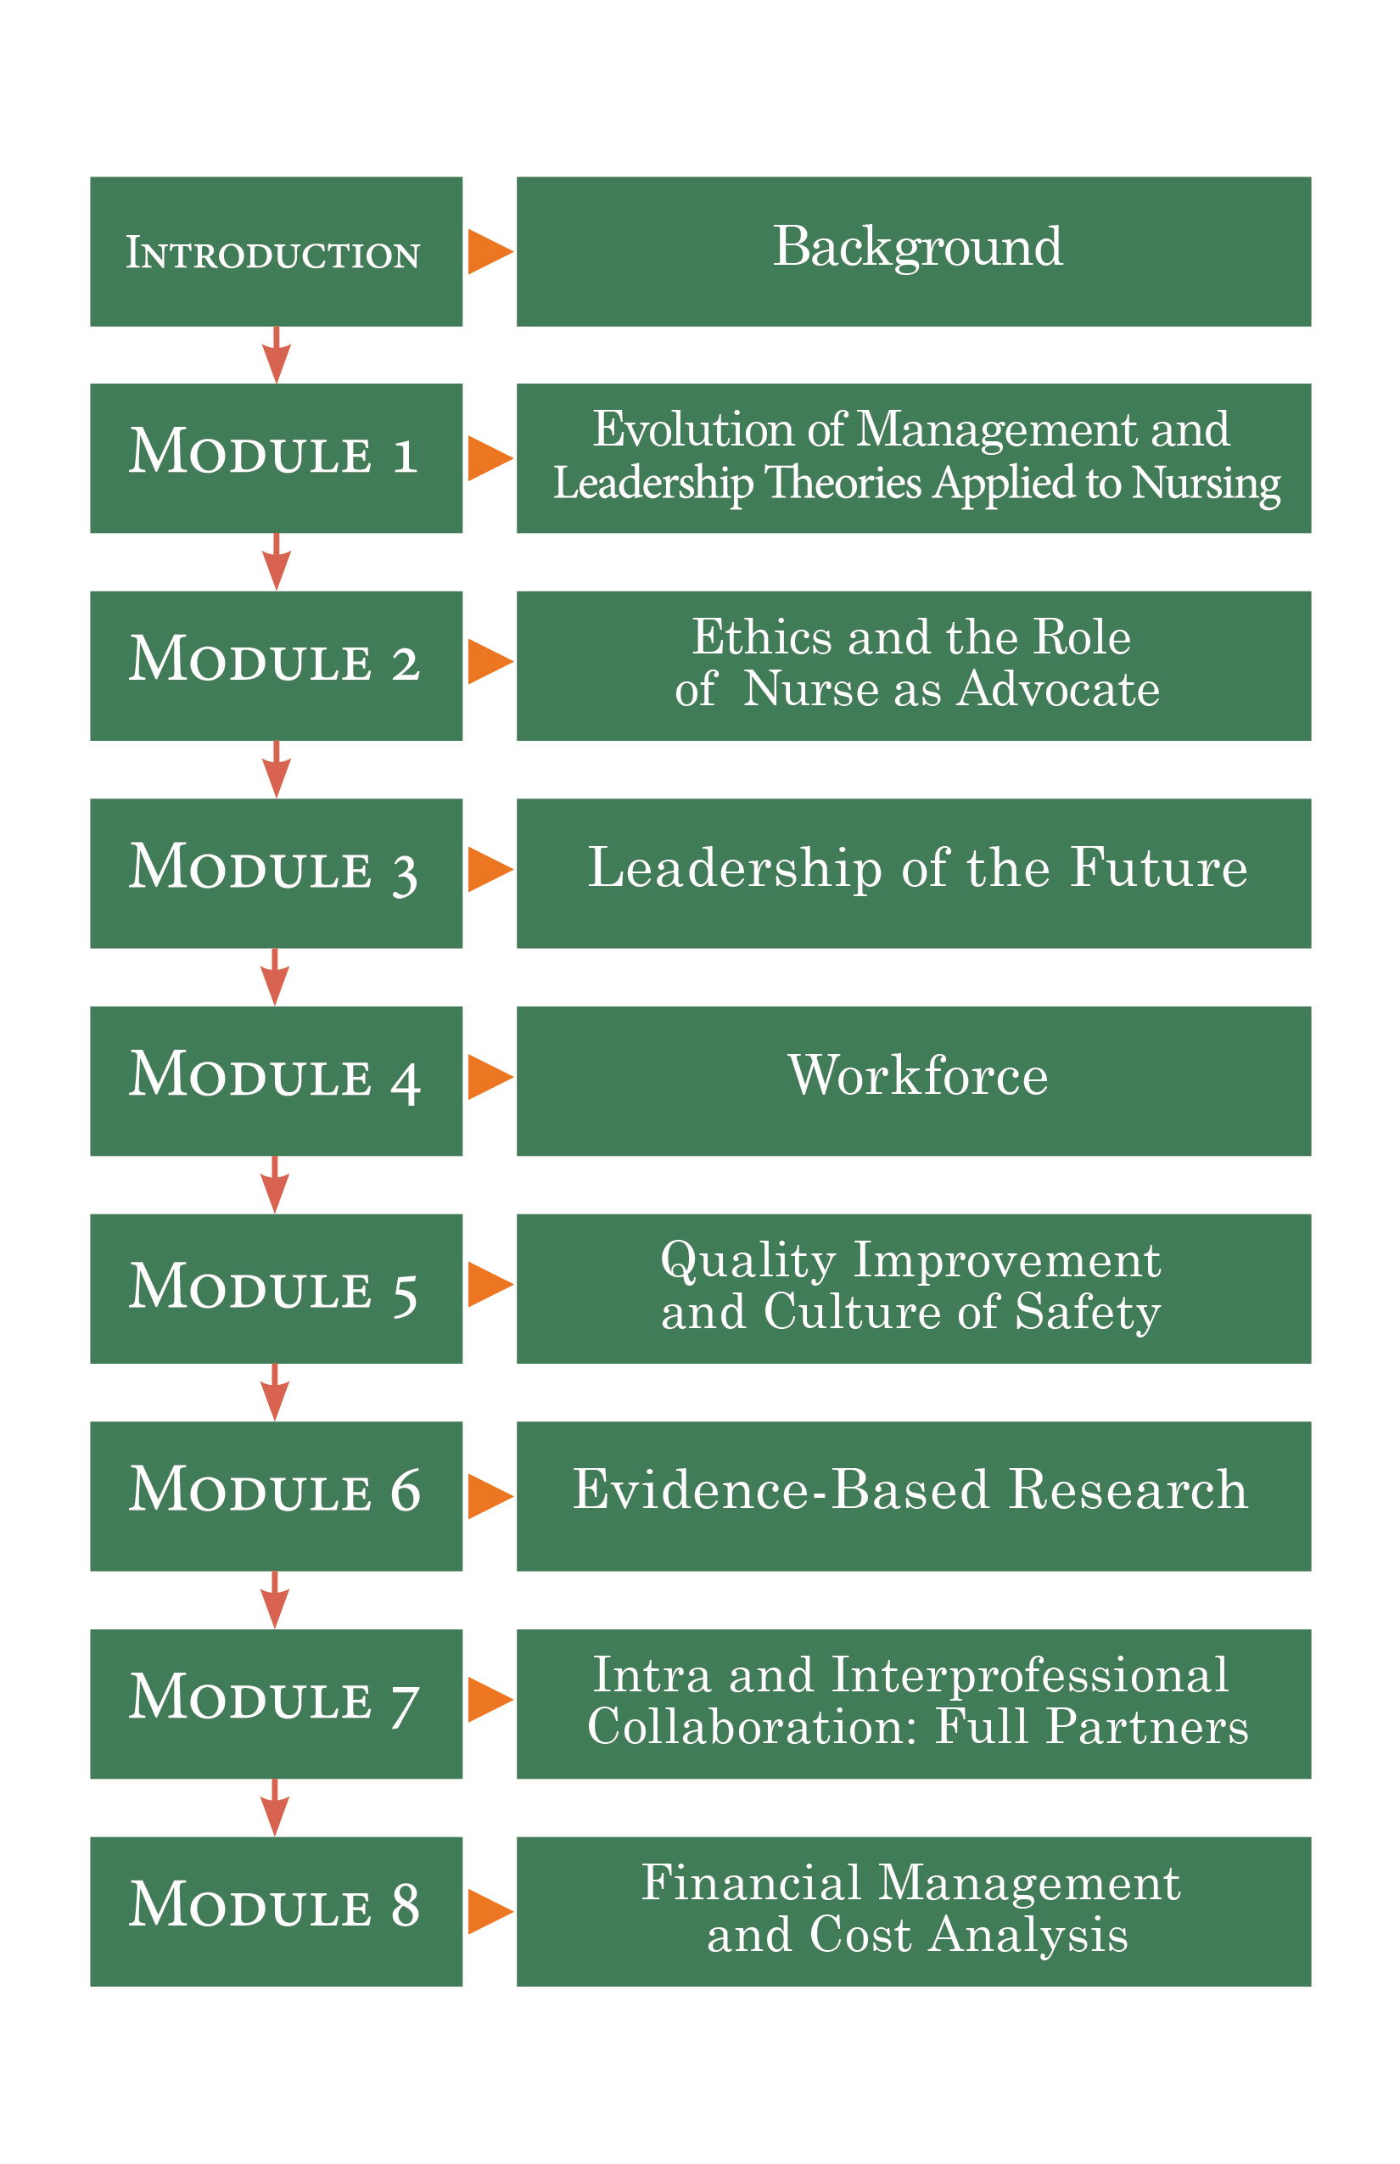
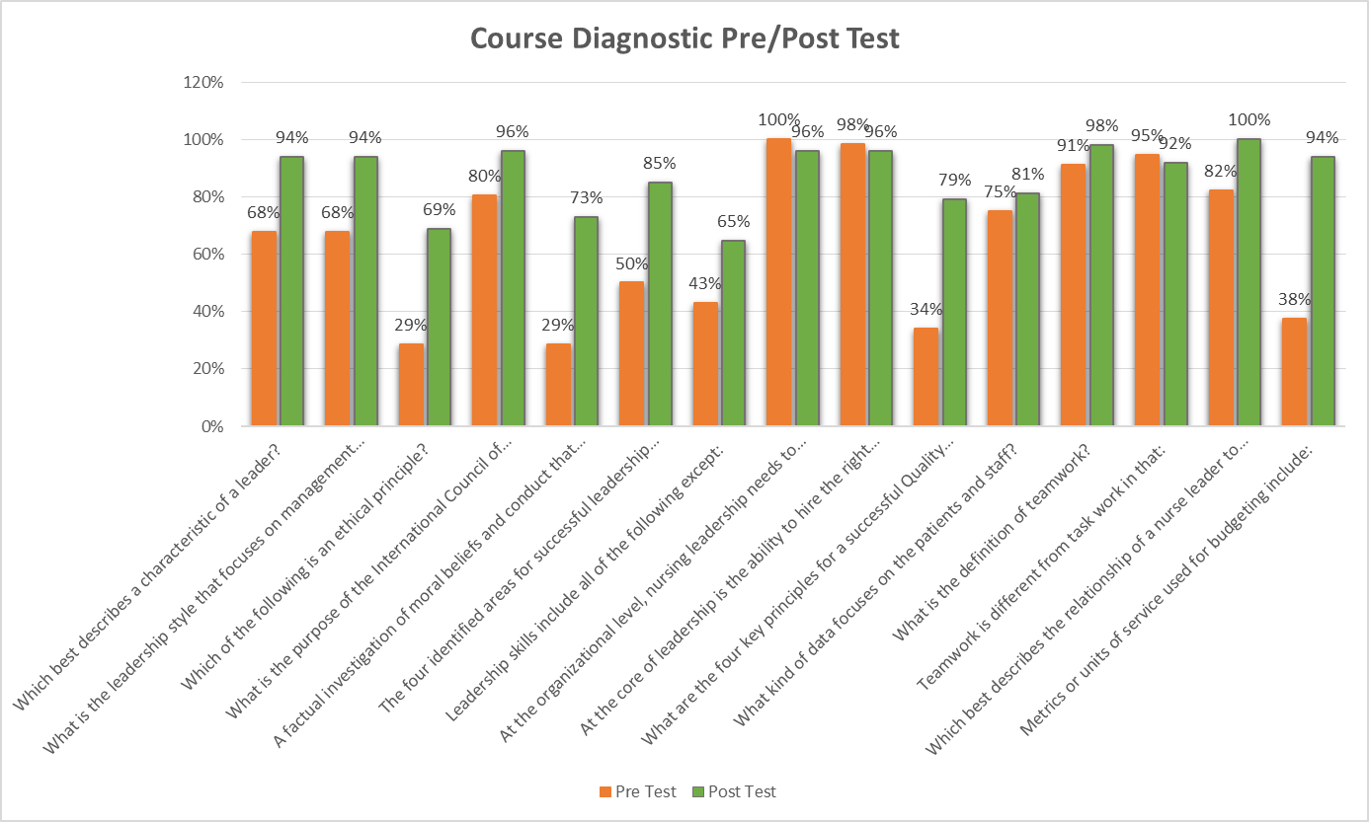
Empowering Nurses in Latin America and the Caribbean via Online Nursing Leadership Course
Ortega, J., Hooshmand, M., Padron, M., Cassiani, S. & Peragallo, N.
University of Miami School of Nursing and Health Studies & Pan American Health Organization
Background:
Development of leadership capacities in nursing workforce of the Americas is essential to achieving Universal Health in the region
Methods:
Online self-learning nursing leadership course consisting of 8 modules over 12 week period
Each participant required to complete a diagnostic pre and post-test assessing knowledge of course content as well as a post-course evaluation module
Results:
58 participants from 24 countries enrolled in the course
83% completed the course
95% ”strongly agreed” or “agreed” that course material was relevant to their professional development
Demand exceeded course enrolment capacity
Knowledge increased post-course
Conclusions:
  Evaluations demonstrate positive satisfaction overall
  Pre and post test results indicate increased knowledge after course completion
  Need for continued collaboration with Caribbean region and beyond to expand availability and address further educational needs of the healthcare workforce.

